Slide 1
Systems Analysis and Design
Chapter Two: Identification, Selection, and Planning phase

Slide 2
1. Identifying and Selecting Projects
The first activity of the systems planning and selection phase of the SDLC is project identification and selection.
Project identification and selection consists of:
Identifying potential development projects
classifying and ranking projects
selecting projects for development

Slide 3
Identifying potential development projects
This process can be performed by:
A key member of top management
A steering committee
User departments
The development group or a senior IS manager

Slide 4
Classifying and ranking IS development projects
Assessing the merit of potential projects is the second major activity in the project identification and selection phase.
The criteria used to evaluate projects usually varies by organization
Possible evaluation criteria when classifying and ranking projects are:
Value chain analysis
Strategic alignment
Potential benefits
Resource availability
Project size/duration
Technical risk/difficulty

Slide 5
Selecting IS development projects
The selection of projects is the final activity in the project identification and selection phase.
Numerous factors are considered when selecting a project including:
Perceived needs of the organization
Existing systems and ongoing projects
Resource availability
Evaluation criteria
Current business conditions

Slide 6
2. Initiating and Planning Systems Development Projects
Project initiation focuses on activities that will help organize a team to conduct project planning. Among the activities performed are:
Establishing the project initiation team
Establishing a relationship with the customer
Establishing the project initiation plan
Establishing management procedures

Slide 7
Project planning focuses on defining clear, discrete tasks and the work needed to complete each task
Among the activities performed are:
Describing the project scope, alternatives, and feasibility
Dividing the project into manageable tasks
Estimating resources and creating a resource plan
Developing a preliminary schedule
Developing a communication plan
Developing a project scope statement
Setting a baseline project plan

Slide 8
The major outcomes and deliverables from project initiation and planning are the baseline project plan and the project scope statement
The baseline project plan (BPP) contains all information collected and analyzed during the project initiation and planning activity
The project scope statement (PSS) clearly describes what the project will deliver and outlines generally at a high level all work required to complete the project.

Slide 9
Assessing Project Feasibility
Assessing project feasibility is an important task that can be a large undertaking because it requires you to evaluate a wide range of factors such as:
Economic
Operational
Technical
Schedule
Legal and Contractual
Political

Slide 10
Assessing Economic Feasibility
The purpose of economic feasibility study is to identify the financial benefits and costs associated with the development project
Benefits can be:
Tangible benefits ( measurable in terms of money)
Intangible benefits (not measurable)
Costs can be:
Tangible
Intangible
one-time cost (associated with dev’t and system start-up)
recurring cost (associated with the ongoing use of the system)

Slide 11
Assessing Other Feasibility Concerns
Operational feasibility:
The process of assessing the degree to which a proposed system solves business problems or takes advantage of business opportunities.
It also means that a proposed system will be used effectively after it has been developed.
If users have difficulty with a new system, it will not produce the expected benefits.

Slide 12
Cont’d..
Technical feasibility:
The process of assessing the development organization’s ability to construct a proposed system.
Schedule feasibility:
The process of assessing the degree to which the potential time frame and completion dates for all major activities within a project meet organizational deadlines and constraints for effecting change.

Slide 13
Legal and contractual Feasibility:
The process of assessing potential legal and contractual ramifications due to the construction of a system.
Political feasibility:
The process of evaluating how key stakeholders within the organization view the proposed system.

Slide 14
Work Breakdown Structure (WBS)
Work breakdown structure (WBS) involves breaking a project down into a series of smaller tasks.
Managing a project as one task is impossible.
WBS is useful because it helps us manage a project in terms of smaller manageable set of tasks.
A work breakdown structure must clearly identify each task and include an estimated duration.

Slide 15
Cont’d..
A task, or activity, is any work that has a beginning and an end and requires the use of company resources such as people, time, or money.
Examples of tasks include conducting interviews, designing a report, selecting software, waiting for the delivery of equipment, or training users.
Tasks are basic units of work that the project manager plans, schedules, and monitors — so they should be relatively small and manageable.

Slide 16
Cont’d..
The important activities in WBS are identifying :
The tasks
The duration of the tasks and
Task patterns
Task pattern refers to the logically arranged sequence of tasks of the project.
Task patterns can involve dependent tasks, multiple successor tasks, and multiple predecessor tasks.

Slide 17
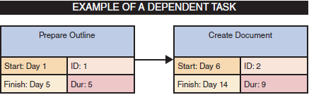
Cont’d..
DEPENDENT TASKS
are tasks that in order to begin depend on the finishing of other tasks.

Slide 18
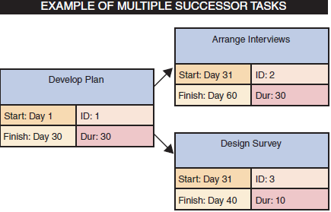
Cont’d..
MULTIPLE SUCCESSOR TASKS
when concurrent tasks, which are tasks that start at the same time, depend on the finishing of another task in order to begin, each concurrent task is called a successor task.

Slide 19
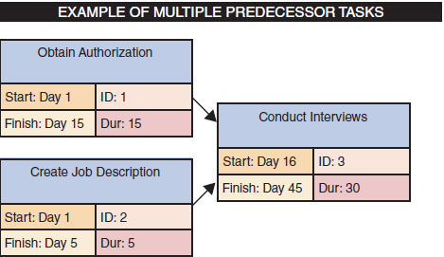
Cont’d..
MULTIPLE PREDECESSOR TASKS
Are tasks that come before a task and that the task depends on their completion in order to begin.

Slide 20
PERT
The Program Evaluation Review Technique (PERT) was developed by the U.S. Navy to manage very complex projects, such as the construction of nuclear submarines.
PERT is a bottom-up technique, because it analyses a large, complex project as a series of individual tasks.
To create a PERT chart:
Identify all the project tasks
estimate how much time each task will take to perform.
determine the logical order in which the tasks must be performed.

Slide 21
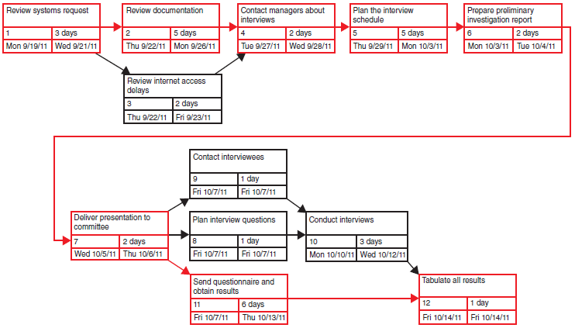
Cont’d..
A critical path is a series of tasks which, if delayed, would affect the completion date of the overall project. In the above example, the tasks coloured in red form the critical path.

Slide 22
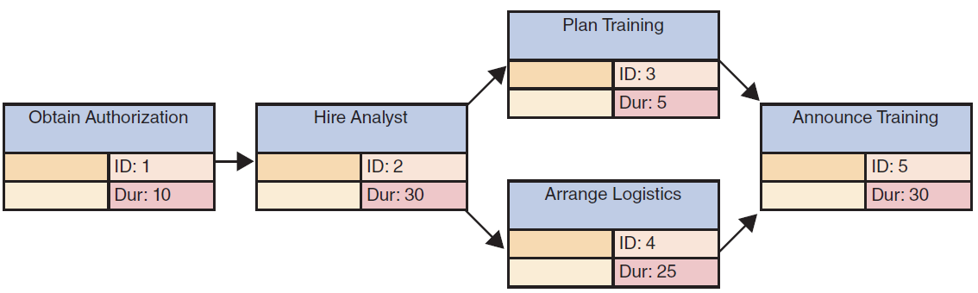
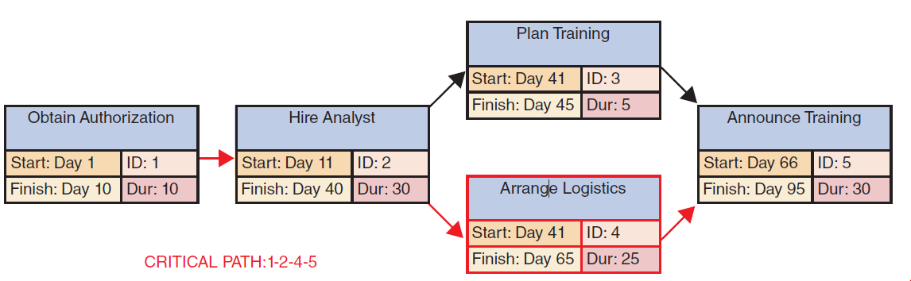
Cont’d..
What is the critical path?

Slide 23
Gantt Chart
Gantt charts were developed almost 100 years ago by Henry L. Gantt, a mechanical engineer and management consultant
A Gantt chart is a horizontal bar chart that represents a set of tasks.
The position of the bar shows the planned starting and ending time of each task, and the length of the bar indicates its duration
A Gantt chart can show task status by adding a contrasting colour to the horizontal bars.

Slide 24
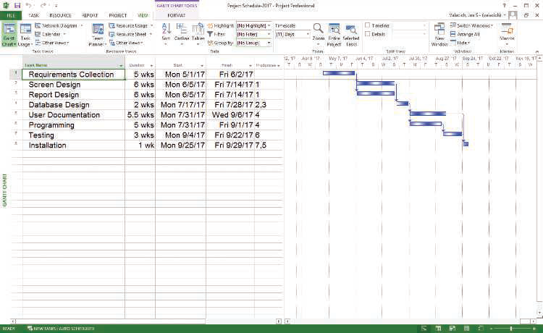
Cont’d..

